Slide 1
Garmin Data Infra Engineer Take-Home Assignment
Chih-Wei Tung

Slide 2
Outline
Selected Services
Services Intro
ETL Implementation
ETL Architecture
ETL Monitoring Video
Monitoring Metrics
Processed Data Visualization
ETL Code

Slide 3
Selected Services
Streaming
Kafka (single cluster, single broker)
Computing Platform
Apache Hadoop - HDFS (single node)
Apache Hive
NoSQL Database
Redis

Slide 4
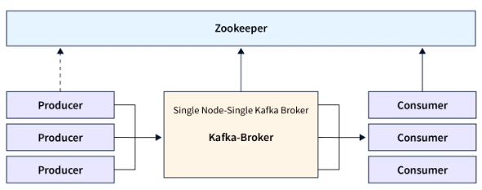
Services Intro - Kafka
A distributed streaming platform, which is used for building real-time/streaming data pipelines.
Zookeeper
Kafka uses Zookeeper to store cluster metadata.
Zookeeper keeps track of which brokers are part of the Kafka cluster
Kafka Key Components
Topic - Like a table in a database, which is the category name of different messages.
Producer and Consumer - Producers and Consumers respectively correspond to the concepts of the publish/subscribe system. Producers can write messages to topics, and Consumers are can read messages from topics.
Broker - Broker receives messages from producers and writes them to disk, and responds to data requests from consumers.
Use Cases - Activity tracking, Real-time data processing, Log aggregation, ...

Slide 5
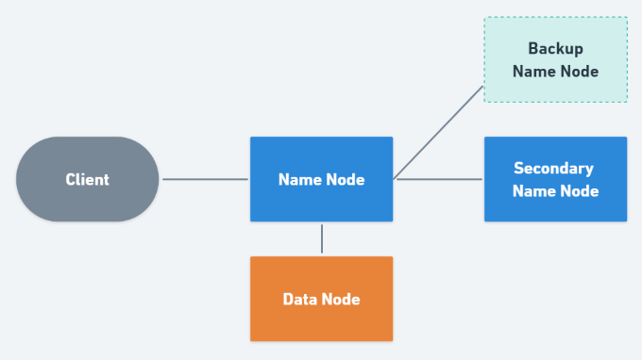
Services Intro - Hadoop HDFS
A distributed file system, designed to reliably store very large files across machines in a large cluster.
HDFS Key Components
Name Node (NN) - NN is the core component of HDFS and manages the entire HDFS. It stores the metadata of all files in the file system. It does not store the data of these files itself.
Secondary Name Node (SN) - It maintain a merged copy of the edit log from primary name node. SN only establishes a restore point for NN, so if NN goes down, SN cannot replace NN.
Backup Name Node (BN) - The function of BN is exactly the same as NN. In addition, it also performs the work of SN. And if NN goes down, BN can just take over right away, and the original NN will be converted to BN after restart.
Data Node (DN) - DN is mainly the node where data is stored. When a file is stored on HDFS, it will break up into blocks with fixed size, and these blocks will be stored in different DNs.

Slide 6
Services Intro - Apache Hive and Redis
Apache Hive
A data warehouse tool based on Hadoop. It can map structured data files into a database table and provide SQL query functions. It can convert SQL statements into MapReduce tasks.
Hive's advantage is that the learning cost is low, simple MapReduce statistics can be quickly realized through SQL statements, and there is no need to develop special MapReduce applications. It is very suitable for statistical analysis of data warehouses.
Redis
A open source, in-memory key-value database used as a database, cache, message broker, and streaming engine.
Redis provides data structures such as strings, hashes, lists, sets, sorted sets with range queries, bitmaps, hyperloglogs, geospatial indexes, and streams.

Slide 7
ETL Implementation
ETL Use Case
Transfer and Analyze IoT Data
Service Monitoring
Kafka - Prometheus, Grafana
HDFS - Hadoop Web Interface
Hive - HiveServer2
Redis - Prometheus, Grafana

Slide 8
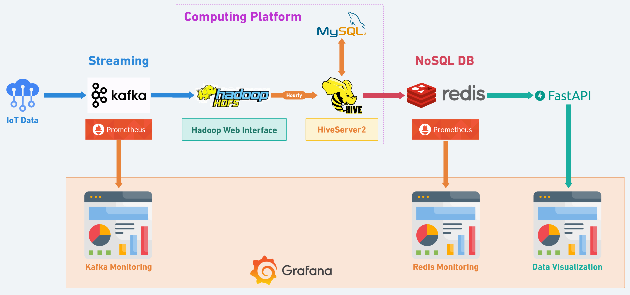
ETL Architecture

Slide 9
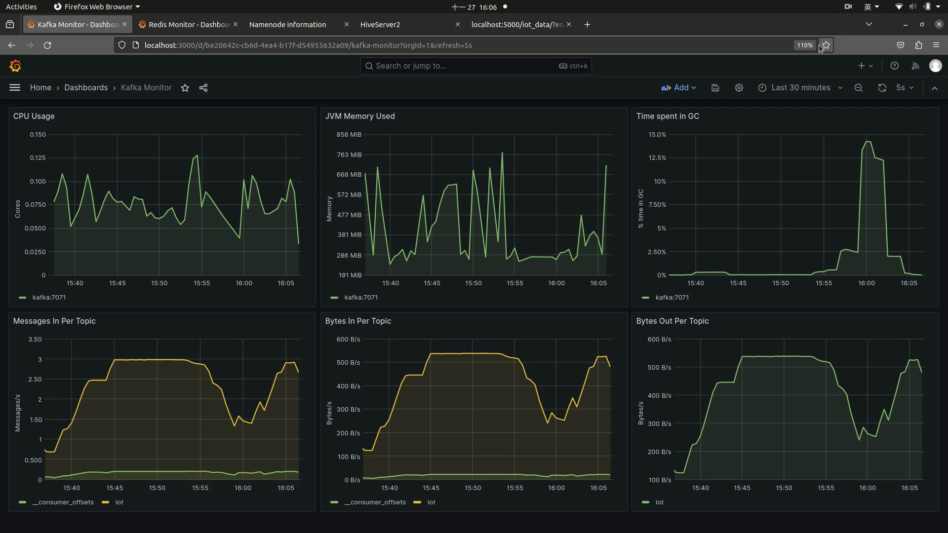
ETL Monitoring Video

Slide 10
Kafka Monitoring Metrics (Prometheus)
CPU Usage
rate(process_cpu_seconds_total{job=”kafka”}[1m])
JVM Memory Used
sum withour(area)(jvm_memory_bytes_used{job=”kafka”})
Time Spent in GC
sum without(gc)(rate(jvm_gc_collection_seconds_sum{job=”kafka”}[5m]))
Messages in Per Topic
sum without(instance)(rate(kafka_server_brokertopicmetrics_messagesin_total{job=”kafka”, topic != “”}[5m]))
Bytes in Per Topic
sum without(instance)(rate(kafka_server_brokertopicmetrics_bytesin_total{job=”kafka”, topic!=””}[5m]))
Bytes out Per Topic
sum without(instance)(rate(kafka_Server_brokertopicmetrics_bytesout_total{job=”kafka”, topic!=””}[5m]))

Slide 11
Redis Monitoring Metrics (Prometheus) cont.
Uptime
max(max_over_time(redis_uptime_in_seconds{instance=~”$instance”}[$__interval]))
Clients
redis_connected_clients{instance=~”$instance”}
Memory Usage
100 * (redis_memory_used_bytes{instance=~”$instance”}) / 8060579872.768)
Commands Executed / sec
rate(redis_command_processed_total{instance=~”$instance”}[1m])
Hits / Misses per Sec
Hits - irate(rate_keyspace_hits_total{instance=~”$instance”}[5m])
Misses - irate(redis_keyspace_misses_total{instance=~”$instance”}[5m])
Total Memory Usage
redis_memory_used_bytes{instance=~”$instance”}

Slide 12
Redis Monitoring Metrics (Prometheus)
Network I/O
input - rate(redis_net_input_bytes_total{instance=~”$instance”}[5m])
output - rate(redis_net_output_bytes_total{instance=~”$instance”}[5m])
Total Items per DB
sum(redis_db_keys{instance=~”$instance”}) by (db)
Expiring vs Not-Expiring Keys
expiring - sum redis_db_keys_expirin{instance=~”$instance”})
not expiring - sum(redis_db_keys{instance=~”$instance”}) - sum redis_db_keys_expirin{instance=~”$instance”})
Expired / Evicted
expired - sum(rate(redis_expired_keys_total{instance=~”$instance”}[5m])) by (instance)
evicated - sum(rate(redis_evicted_keys_total{instance=~”$instance”}[5m])) by (instance)
Command Calls / sec
topk(5, irate(redis_commands_total{instance=~”$instance”}[1m]))

Slide 13
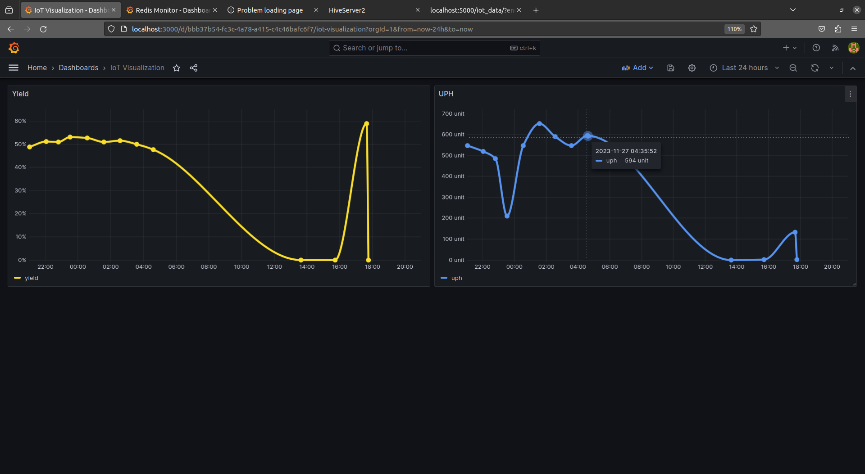
Processed Data Visualization

Slide 14
ETL Code

